Slide 1
User Research Summary
Prepared by the Digital Service at Veterans Affairs (DSVA)
Prepared for and presented to the VA Web Brand Consolidation Working Group
October 1, 2018

Slide 2
Outline
We gathered feedback from hundreds of Veterans about our plans for a new va.gov experience.
Study 1 – “Others” Resources Card Sort
Study 2 – Benefit Lifecycle Card Sort
Study 3 – Homepage Wireframe Tests
Study 4 – Navigation Tree Tests
Study 5 – Preview.va.gov Usability Test 1
Study 6 – Preview.va.gov Non-VA Vets
Study 7 – Preview.va.gov Usability Test 2
Study 8 – Preview.va.gov Authenticated Test

Slide 3
Study 1 – “Others” Resources Card Sort

Slide 4
Our goal was to learn how to organize the "other" resources that don’t fit into the benefit categories.
Study 1 – “Others” Resources Card Sort
Created an open card sort in Optimal Workshop
20 cards, user creates categories
Distributed to 4k Veterans via MyHealtheVet mailing list
Received 155 responses (Apr 5 – Apr 20)
95% Veterans, a few caregivers and family members

Slide 5
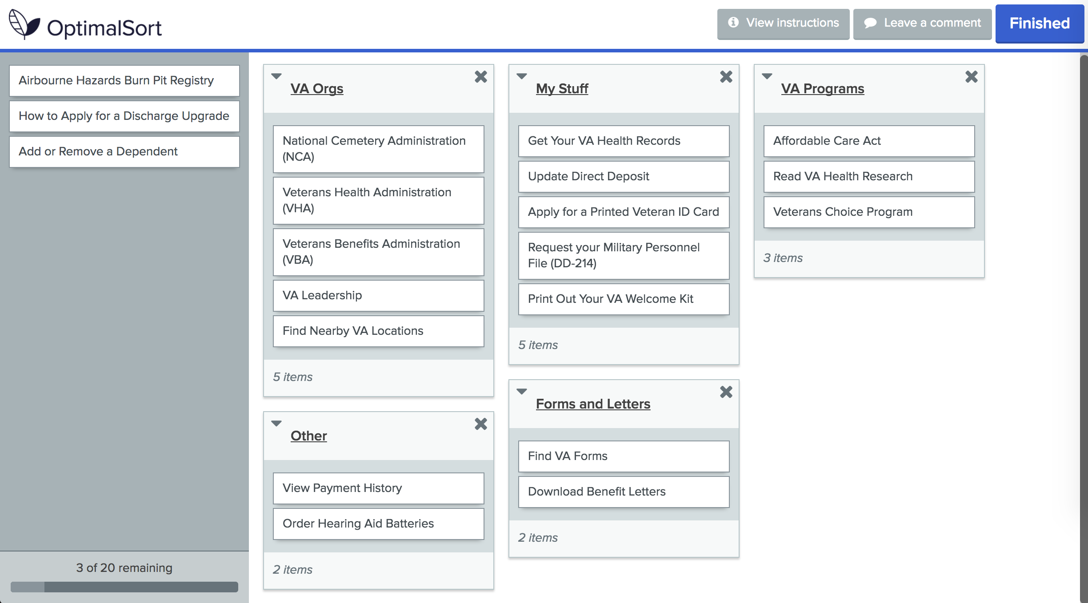
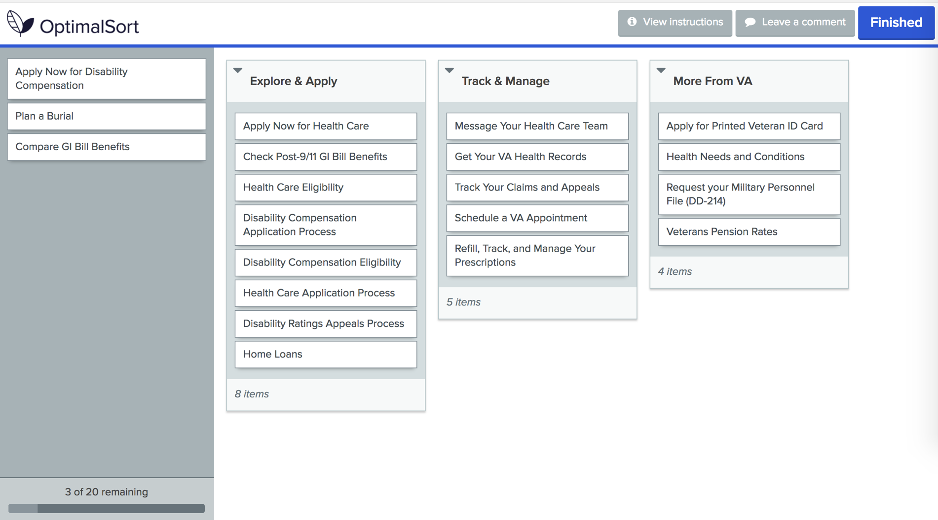

Slide 6
Veterans don’t agree on what to call these groups of content
Study 1 – “Others” Resources Card Sort
Veteran’s groups had low agreement scores but provide valuable labels
Account Information / Management
About the VA
My VA / For Me
Most Important (focused on health due to audience)
Self Service / Online
Airborne Hazards and Ordering Hearing Aid Batteries were consistently outliers

Slide 7
What did we learn?
Study 1 – “Others” Resources Card Sort
We confirmed that there is no clear or consistent way to group and label all the “other” content but the data still show items with the strongest relationship and provide Veteran-focused labels.

Slide 8
Study 2 – Benefit Lifecycle Card Sort

Slide 9
Our goal was to find if our proposed benefit lifecycle works for Veterans.
Study 2 – Benefit Lifecycle Card Sort
Created a closed card sort in Optimal Workshop
20 cards, 3 categories
Distributed to 4k Veterans via MyHealtheVet mailing list
Received 240 responses (Apr 5 – Apr 20)
95% Veterans, several spouses and other family

Slide 11
Some content worked better than others
Study 2 – Benefit Lifecycle Card Sort
Explore & Apply
Track and Manage
More From VA
Health Care Application Process
Health Care Eligibility
Apply Now for Health Care
Disability Compensation Eligibility
Disability Compensation Application Process
Apply Now for Disability Compensation
Apply for Printed Veteran ID Card
Refill, Track, and Manage Your Prescriptions
Message Your Health Care Team
Schedule a VA Appointment
Get Your VA Health Records
Track Your Claims and Appeals
Check Post-9/11 GI Bill Benefits
Request your Military Personnel File (DD-214)
Health Needs and Conditions
Disability Ratings Appeals Process
Compare GI Bill Benefits
Veterans Pension Rates
Plan a Burial
Home Loans

Slide 12
Organizing benefits around the lifecycle makes sense to Veterans
Study 2 – Benefit Lifecycle Card Sort
Explore & Apply works well for the items we thought fit in that category like “Health Care Eligibility”
Many Track & Manage cards were consistently sorted by Veterans, but other items including “Request DD-214” don’t fit
Several items including “Compare GI Bill Benefits” aren’t easily placed in only one category
More From VA cards had the most inconsistent placement but did not distract Veterans from the benefit lifecycle

Slide 13
What did we learn?
Study 2 – Benefit Lifecycle Card Sort
We learned that the benefit lifecycle can work as part of the content strategy but applying it to the content hubs will take finesse.

Slide 14
Study 3a – Homepage Wireframes v1

Slide 15
Our goal was to gather feedback on two homepage designs
Study 3a – Homepage Wireframes v1
Visited DC Medical Center – Women’s Clinic
Spoke with 10 women Veterans of varying ages and races
Showed them two options for a new homepage (paper wireframes)
Asked structured questions to gather feedback

Slide 16
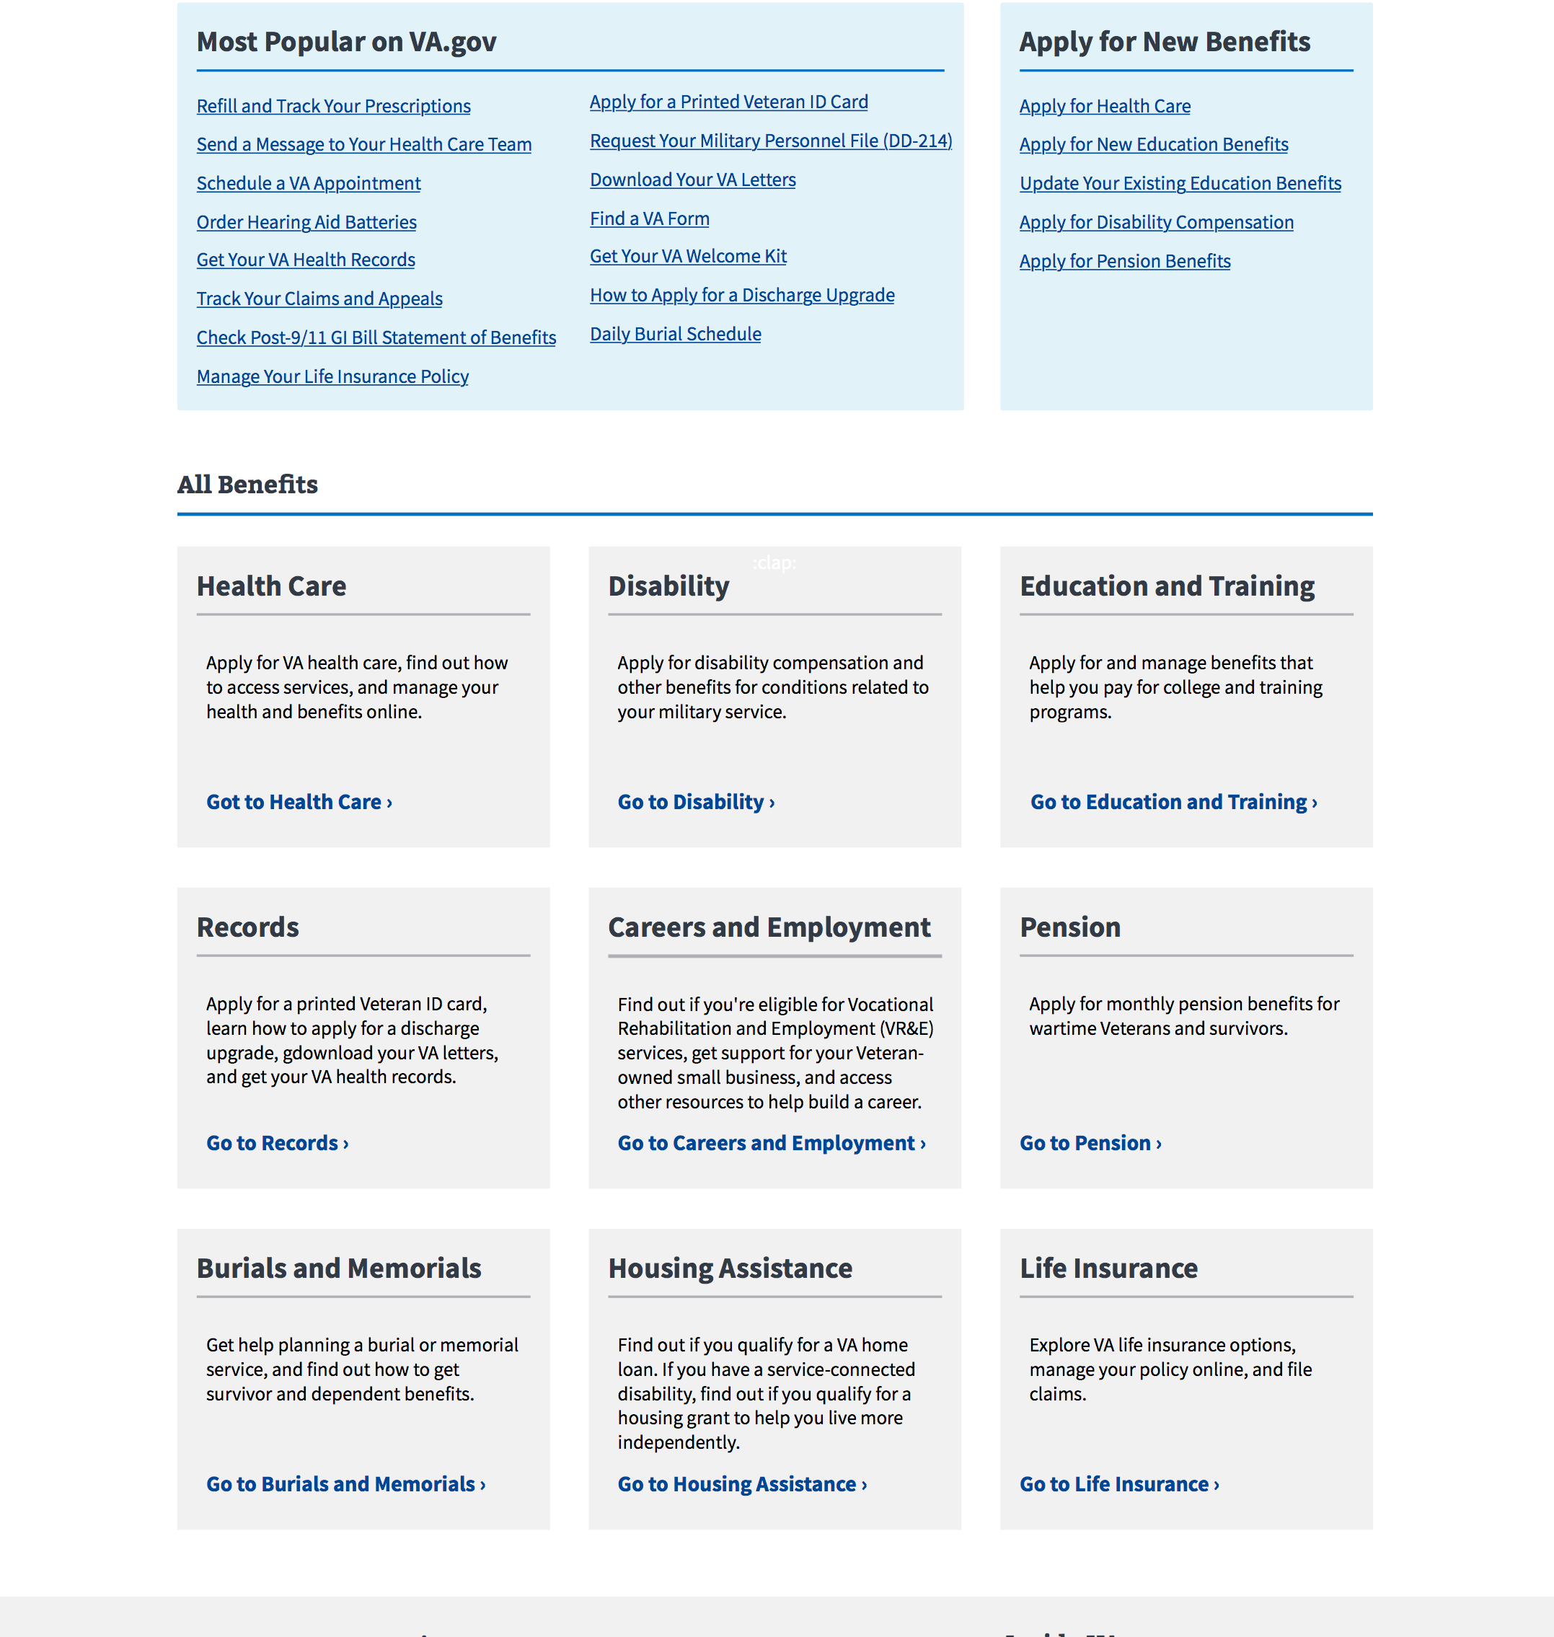
Top Tasks Homepage
Study 3a – Homepage Wireframes v1
Zone 2 focused on the top tasks available to Veterans split between recurring “manage” and one time “apply” boxes
Zone 3 listed each benefit category with a simple description and CTA

Slide 17
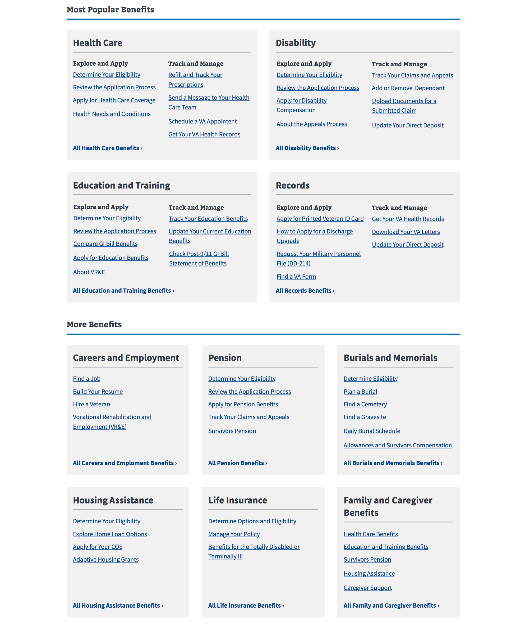
Benefit Category Homepage
Study 3a – Homepage Wireframes v1
Zone 2 listed the top 4 benefit categories with top tasks listed under “Explore & Apply” or “Track & Manage”
Zone 3 showed the remaining benefits with lists of top tasks for each

Slide 18
We learned that Veterans want the context of the benefit category but also quick links
Study 3a – Homepage Wireframes v1
7/10 preferred “Benefit Category” design over “Top Tasks”
Benefit hubs were confirmed as a good organization method
Veterans wanted the most popular list in each benefit but were overwhelmed by the number of choices
Separating top tasks from benefit labels was “distracting”
Both designs were “clean” but “boring” and needed more images
Appreciation for the one-click access to top resources

Slide 19
What Now?
Study 3a – Homepage Wireframes v1
We are updating our designs to incorporate the user feedback. These designs will go to our next round of user testing.

Slide 20
Study 3b – Homepage Wireframes v2

Slide 21
Our goal was to learn more about what works best in each design
Research Study 3b – Homepage Wireframes v2
Visited Ft Belvoir CBOC (part of DC MC)
Spoke with 9 men Veterans of varying ages and races
Showed them two revised homepage designs (paper wireframes)
Asked structured questions to gather feedback (similar questions to study 3a)

Slide 22
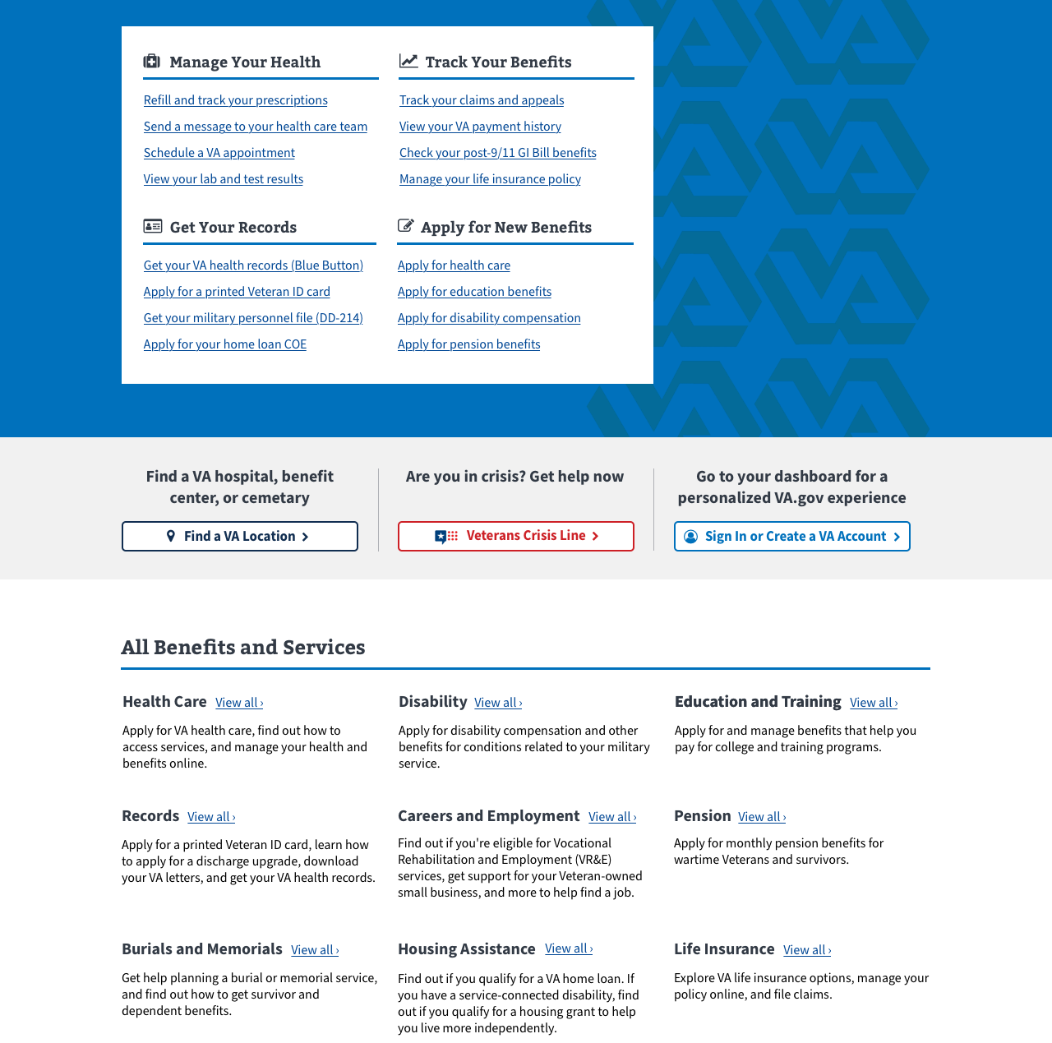
Top Tasks Homepage v2
Research Study 3b – Homepage Wireframes v2
Zone 1 focused on the top tasks organized under manage health, track benefits, get records, apply for benefits
Zone 2 had the location, crisis line, and sign-in
Zone 3 listed each benefit category with a simple description and CTA

Slide 23
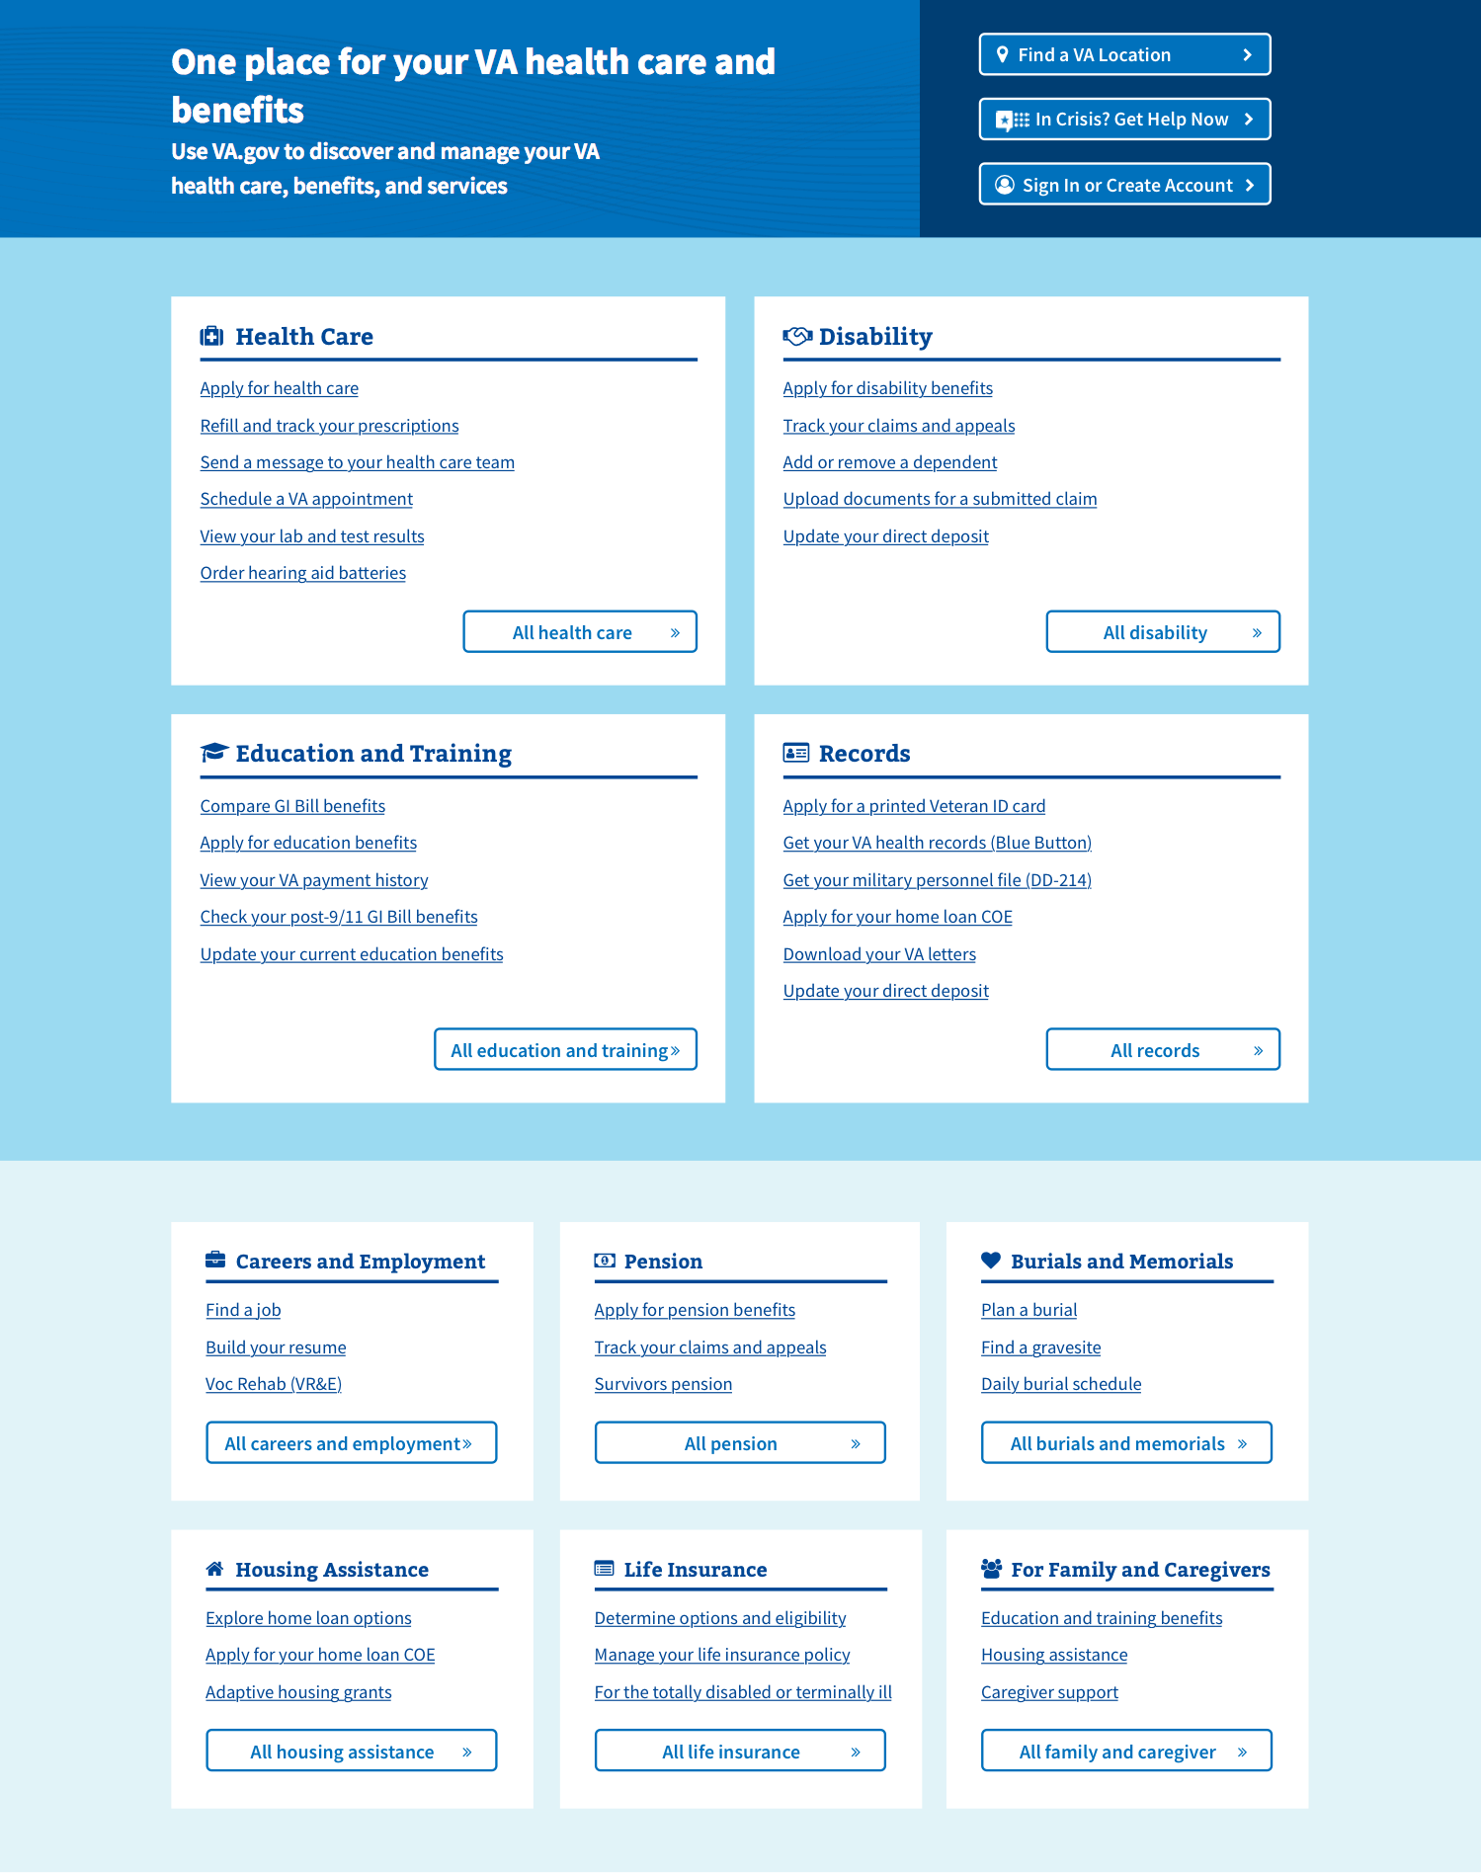
Benefit Category Homepage v2
Research Study 3b – Homepage Wireframes v2
Zone 1 had the location, crisis line, and sign-in
Zone 2 listed the top 4 benefit categories with top tasks
Zone 3 showed the remaining benefits with lists of top tasks for each

Slide 24
Veterans prefer the benefit category design with some modifications
Research Study 3b – Homepage Wireframes v2
The default mental model for Veterans is benefit category first then task
Veterans had difficulty finding information using the headings in the top tasks design
CTA buttons in the top task design (color and placement) worked best
The layout of the top benefit categories worked well
Both designs are boring and need more color
Veterans want the page to be simple and not cluttered
Veterans want large, clear, text and icons
One-click access and “above the fold” priority are important to Veterans

Slide 25
What Now?
Research Study 3b – Homepage Wireframes v2
The benefit category is the default mental model for organizing information, but top tasks are why users come to va.gov.
Our next design will combine the best of both concepts.

Slide 26
Study 4a – Navigation Tree Test v1

Slide 27
Our goal was to validate the navigation model for VA.gov
Study 4a – Navigation Tree Test v1
Created a tree test in Optimal Workshop
User given 10 out of 30 possible tasks
Tries to navigate through the menu to find the answer
Distributed to 10k Veterans via MyHealtheVet mailing list
Received 715 responses (June 18-20)
97% Veterans, limited family members and caregivers

Slide 28
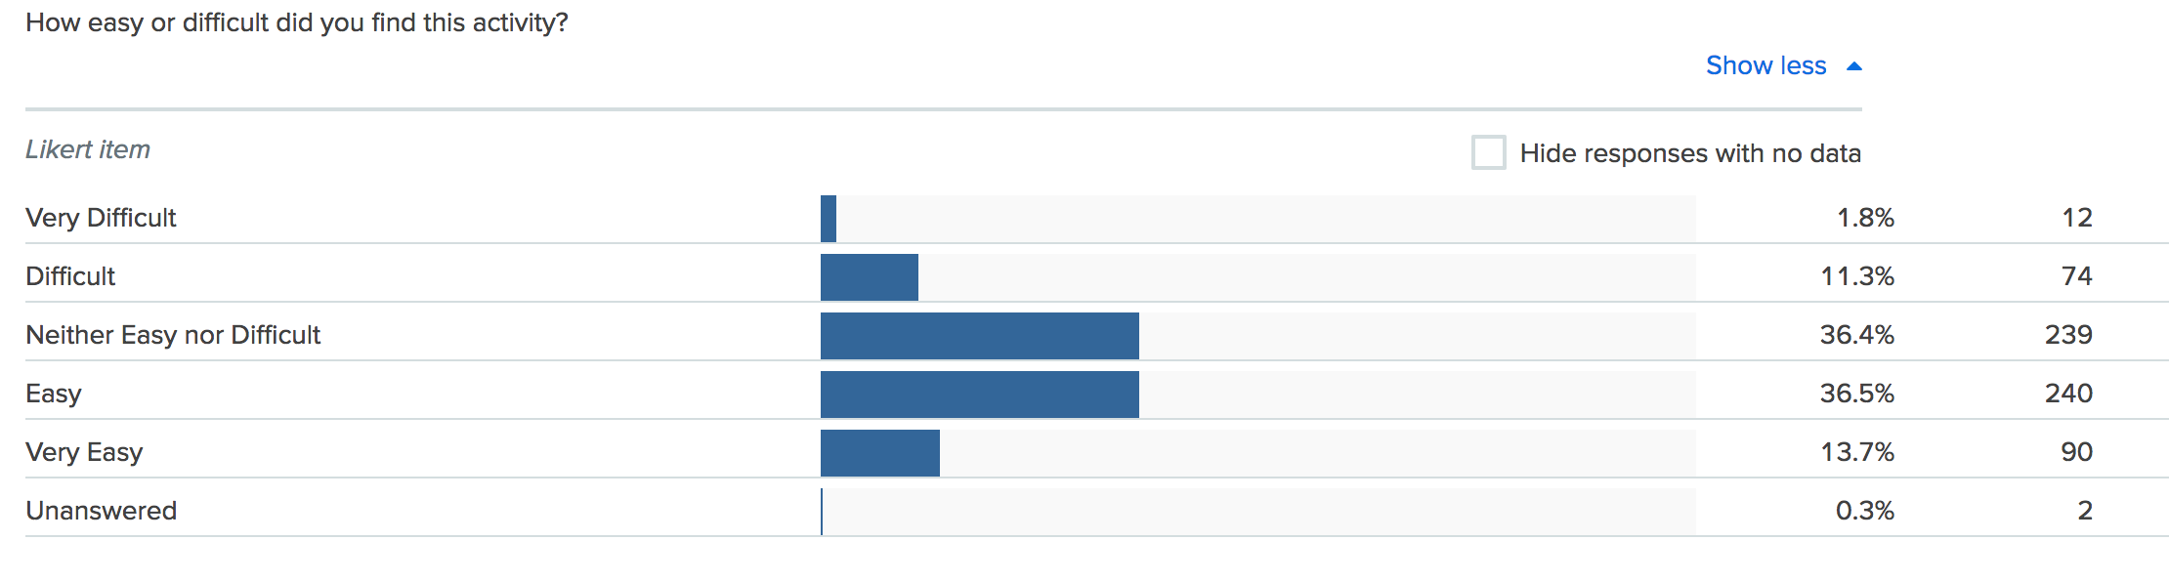
Veterans generally found the study easy to complete
Study 4a – Navigation Tree Test v1

Slide 29
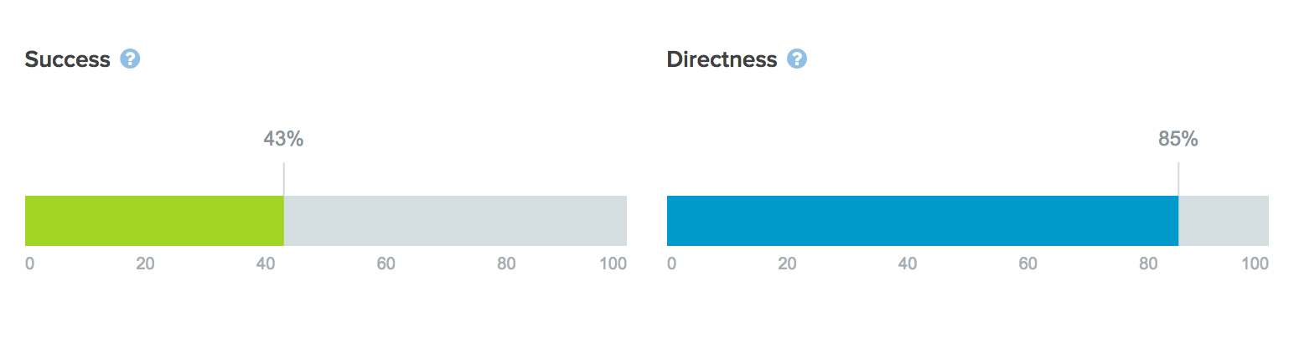
Overall, the results were not great
Study 4a – Navigation Tree Test v1

Slide 30
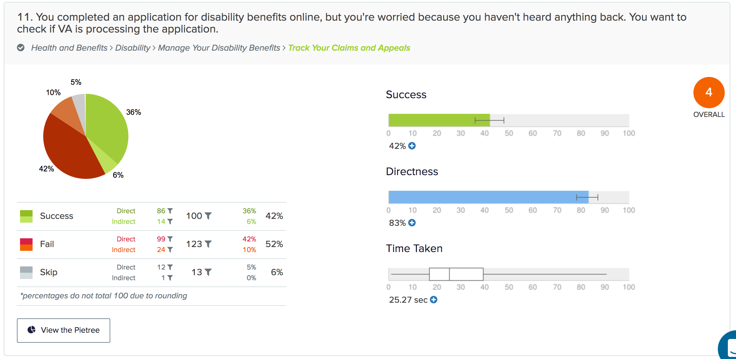

Slide 31
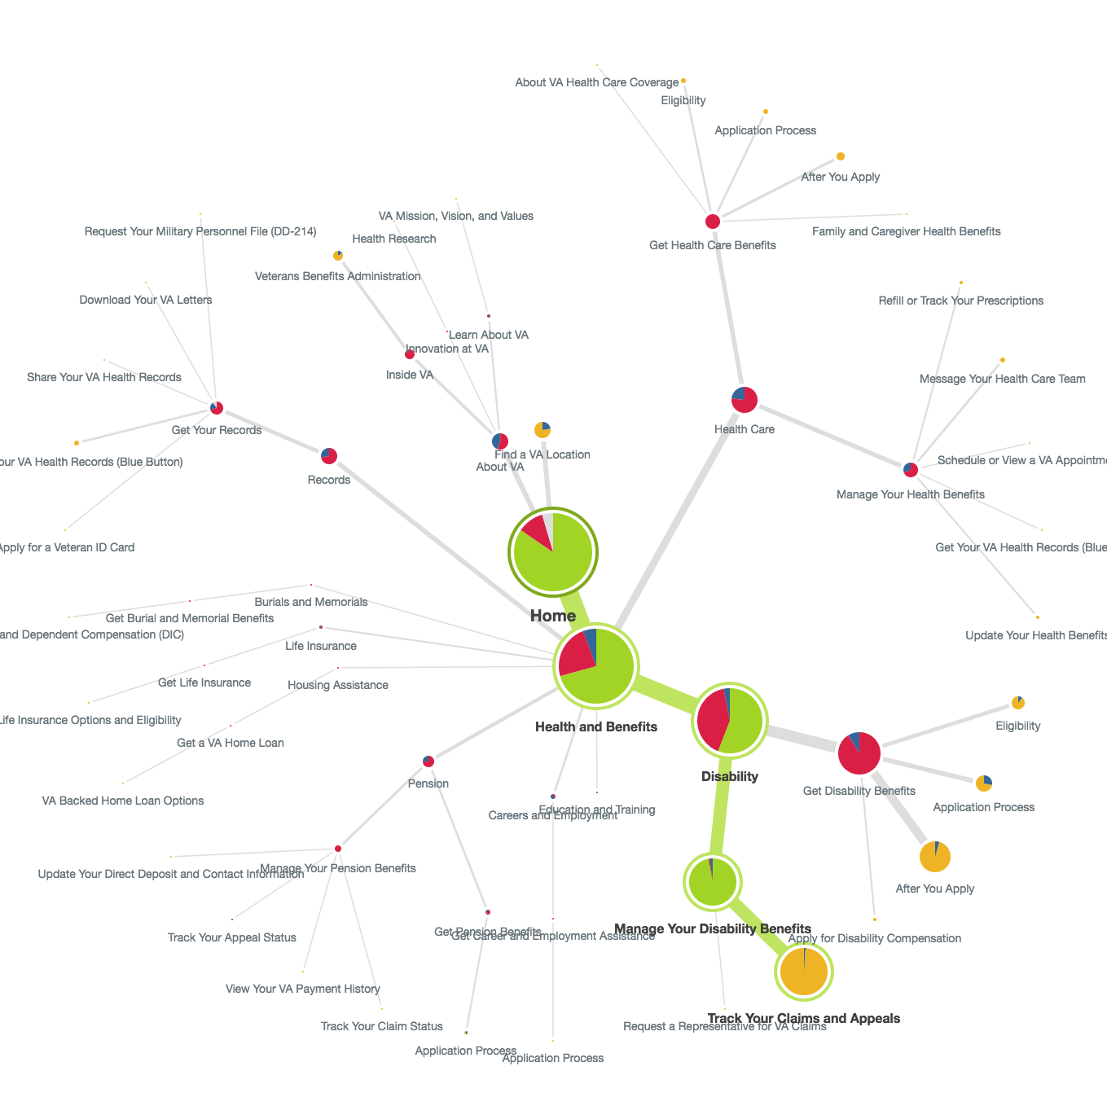

Slide 35
Veterans struggled to navigate the menu to complete top tasks
Study 4a – Navigation Tree Test v1
Scores ranged from 2 - 6 (we want 7 and above)
Directness scores indicate that users were confident in their incorrect answers
The sheer volume of content and number of levels in the menu contributed to the overall poor performance
Choosing between “Get” and “Manage” benefits continued to distract users

Slide 36
Top tasks
Study 4a – Navigation Tree Test v1
Health Care tasks – Both “About VA” and “Find a VA Location” were common incorrect paths
For health conditions information – “About VA” was a common path
Health tasks mostly scored 4s, ranged 3-5.
Disability tasks – Users were looking in the Health hub for “Apply” tasks and in the Records hub for “track and manage” tasks
Upload Docs and Add/Remove Dependent scored 2s. Others 4-5.
Education tasks – Users frequently chose incorrect “apply” links. Scores ranged 4-5.

Slide 37
More tasks
Study 4a – Navigation Tree Test v1
Records tasks – “About VA” was a common incorrect path. Scores 3-6.
Pension tasks – Disability hub was the most common incorrect path. Scored all 4s.
Jobs task – “About VA” was the first misstep for most users but many were also confused by “Get” vs “Manage”. Score 2.
Cemetery tasks – Scored 6s, generally good with some distraction by “About VA” and “Pre-Need”.
Facility Locator – Scored 9. Listed at the top level of nav.
About VA tasks – Scored 2s. Largely done as an info gathering activity, needs more research.

Slide 38
We need to update our navigation and apply the lessons learned
Study 4a – Navigation Tree Test v1
Simplify the mega menu options by reducing the number of links per section
Consolidate the “Apply” entry points in the menu for each benefit
Cross-link between the Health, Disability, Pension, and Records hubs for alternative navigation paths
Cross-link from the Facility Locator and Facility pages to the Health hub
Re-organize the Jobs menu options
Discuss “About” Menu top tasks

Slide 39
What Now?
Study 4a – Navigation Tree Test v1
More research!
We learned a lot from this first study and need to make some big improvements to the menu options. Next, we will run the same tasks against the new design and watch for improvements.

Slide 40
Study 4b – Navigation Tree Test v2

Slide 41
Our goal was to determine if a simplified mega menu is a reasonable solution to va.gov
Study 4b – Navigation Tree Test v2
Created a tree test in Optimal Workshop
User given 9 out of 28 possible tasks
Tries to navigate through the menu to find the answer
Distributed to 8k Veterans via MyHealtheVet mailing list
Received 596 responses (June 18-20)
96% Veterans, 3% Spouses, limited other family members and caregivers

Slide 42
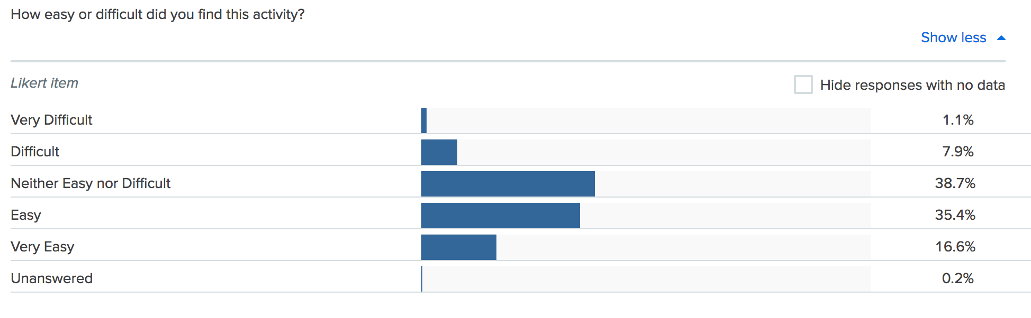
Veterans found the study easy to complete
Study 4b – Navigation Tree Test v2

Slide 43
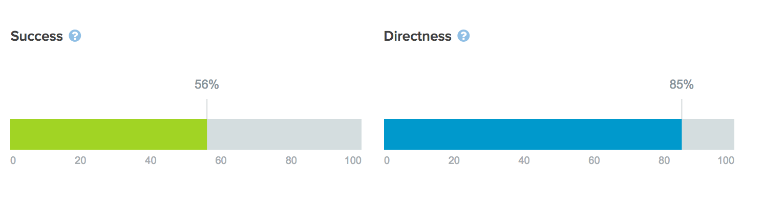
Overall, the results improved with the simplified design
Study 4b – Navigation Tree Test v2

Slide 44
Health & Disability
Study 4b – Navigation Tree Test v2
Health tasks generally performed well
About VA was a contributing distraction for health tasks (~10%)
Many Veterans looked in Records for disability management tasks (upload docs, direct deposit, add dependents)
Health Care and Pension were also commonly visited during disability tasks

Slide 45
Education, Records, Home Loan
Study 4b – Navigation Tree Test v2
About VA was the only consistent distractor on Education tasks (~28%)
About VA was the biggest distractor for Veteran ID (31%) and DD-214 (44%)
Disability was commonly visited when looking for VA Letters (38%)
About VA distracted from Home Loan COE (36%)

Slide 46
Pension and Jobs
Study 4b – Navigation Tree Test v2
About VA was a large distractor from Pension tasks
The other links in the Pension Hub distracted Veterans more than other hubs (81% success rate)
Most Veterans looked for Find a Job under About VA (62%)

Slide 47
Burials & About VA
Study 4b – Navigation Tree Test v2
Veterans looked under About VA for Find a Cemetery (44%)
Health Care was the most common destination for Veterans Choice Program
The other About VA categories (Learn, Innovation) were distractors from finding the Public Affairs content

Slide 48
Health Care Tasks
Study 4b – Navigation Tree Test v2
Task | Success | Primary Incorrect Paths
Apply | 69% | About VA (12%) / HC→About VA HC
Refill Prescription | 88% | None
Secure Messaging | 74% | About VA (10%) / Records
Online Scheduling | 76% | About VA (11%) / Records
Labs and Tests | 63% | Records → Blue Button (24%)
Hearing Aids | 77% | About VA (3%) / Disability
About | 72% | About VA (9%) / Disability / Education and Training

Slide 49
Disability Tasks
Study 4b – Navigation Tree Test v2
Task | Success | Primary Incorrect Paths
Apply | 61% | Health, Pension, Records (24%) / Eligibility (11%)
Eligibility | 50% | Health Care (19%) / About VA (11%)
Track Claims | 63% | About VA (21%) / Health, Records (17%)
Upload Docs | 51% | Records (16%) / Health, Pension (18%) / About VA (12%)
Add or Remove Dependent | 38% | Family and Caregivers (21%) / Records (11%) / Pension (11%)
Update Direct Deposit | 48% | About VA (38%) / Records (17%)

Slide 50
Education Tasks
Study 4b – Navigation Tree Test v2
Task | Success | Primary Incorrect Paths
Apply | 67% | About VA (23%)
Check GI Bill | 54% | About VA (32%)

Slide 51
Records & Home Loan
Study 4b – Navigation Tree Test v2
Task | Success | Primary Incorrect Paths
Veteran ID | 60% | About VA (31%) / Health Care (13%)
DD-214 | 60% | About VA (44%)
Blue Button | 70% | Health Care (26%)
VA Letters | 36% | Disability (38%) / About VA (16%)
Task | Success | Primary Incorrect Paths
Home Loan COE | 45% | About VA (36%) / HA→ How to Apply (10%)

Slide 52
Pension
Study 4b – Navigation Tree Test v2
Task | Success | Primary Incorrect Paths
Apply | 55% | About VA (19%) / Other Pension (13%)
Track Claim | 57% | About VA (18%) / Other Pension (12%)
Payment History | 52% | About VA (17%) / Records, Disability (16%)

Slide 53
Pension & Careers
Study 4b – Navigation Tree Test v2
Task | Success | Primary Incorrect Paths
Apply | 55% | About VA (19%) / Other Pension (13%)
Track Claim | 57% | About VA (18%) / Other Pension (12%)
Payment History | 52% | About VA (17%) / Records, Disability (16%)
Task | Success | Primary Incorrect Paths
Find a Job | 31% | About VA (62%)

Slide 54
Burials & About VA
Study 4b – Navigation Tree Test v2
Task | Success | Primary Incorrect Paths
Burial Allowances | 73% | About VA (12%) / Other Burial links (10%)
Find a Cemetery | 42% | About VA (44%) / Other Burial links (11%)
Task | Success | Primary Incorrect Paths
Veterans Choice | 8% | Health Care (80%)
Public Affairs | 29% | Learn About VA (41%) / Innovation at VA (16%)

Slide 55
We learned that the mega menu navigation model can work for VA
Study 4b – Navigation Tree Test v2
We may want to consider a term other than “About VA” to help distinguish benefits content from other VA content
We still have to rely heavily on cross-linking the hubs and redirecting users back from About VA pages to the benefits content
Each Hub will need additional research to refine the terms used

Slide 56
What Now?
Study 4b – Navigation Tree Test v2
Now that we’ve found a way to organize the massive content list for VA.gov, we must run individual studies to test the content in each Hub.

Slide 57
Study 5 – Preview.va.gov Usability Test

Slide 58
Our goal was to assess the usability of the preview.va.gov on desktop and mobile
Study 5 – Preview.va.gov Usability Test
Visited Minneapolis, MN VAMC
Spoke with 14 Veterans of varying ages and races
8 Desktop, 6 Mobile
Used the live preview.va.gov website
Asked structured interview questions to gather feedback about the homepage, navigation, hub pages, and tool landing pages

Slide 59
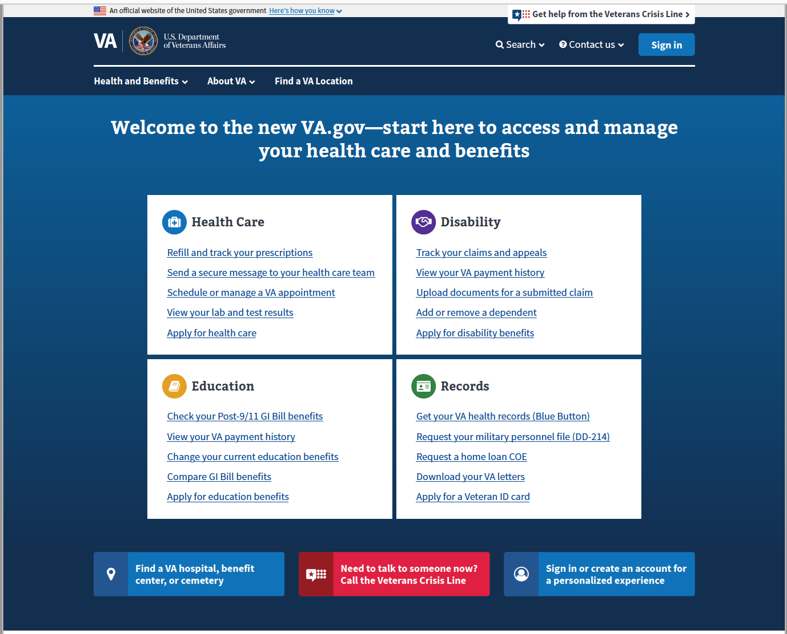
Preview.va.gov Homepage
Study 5 – Preview.va.gov Usability Test
Focused on first impressions and first clicks from the homepage
Directed users to the mega menu for feedback on options and usefulness

Slide 60
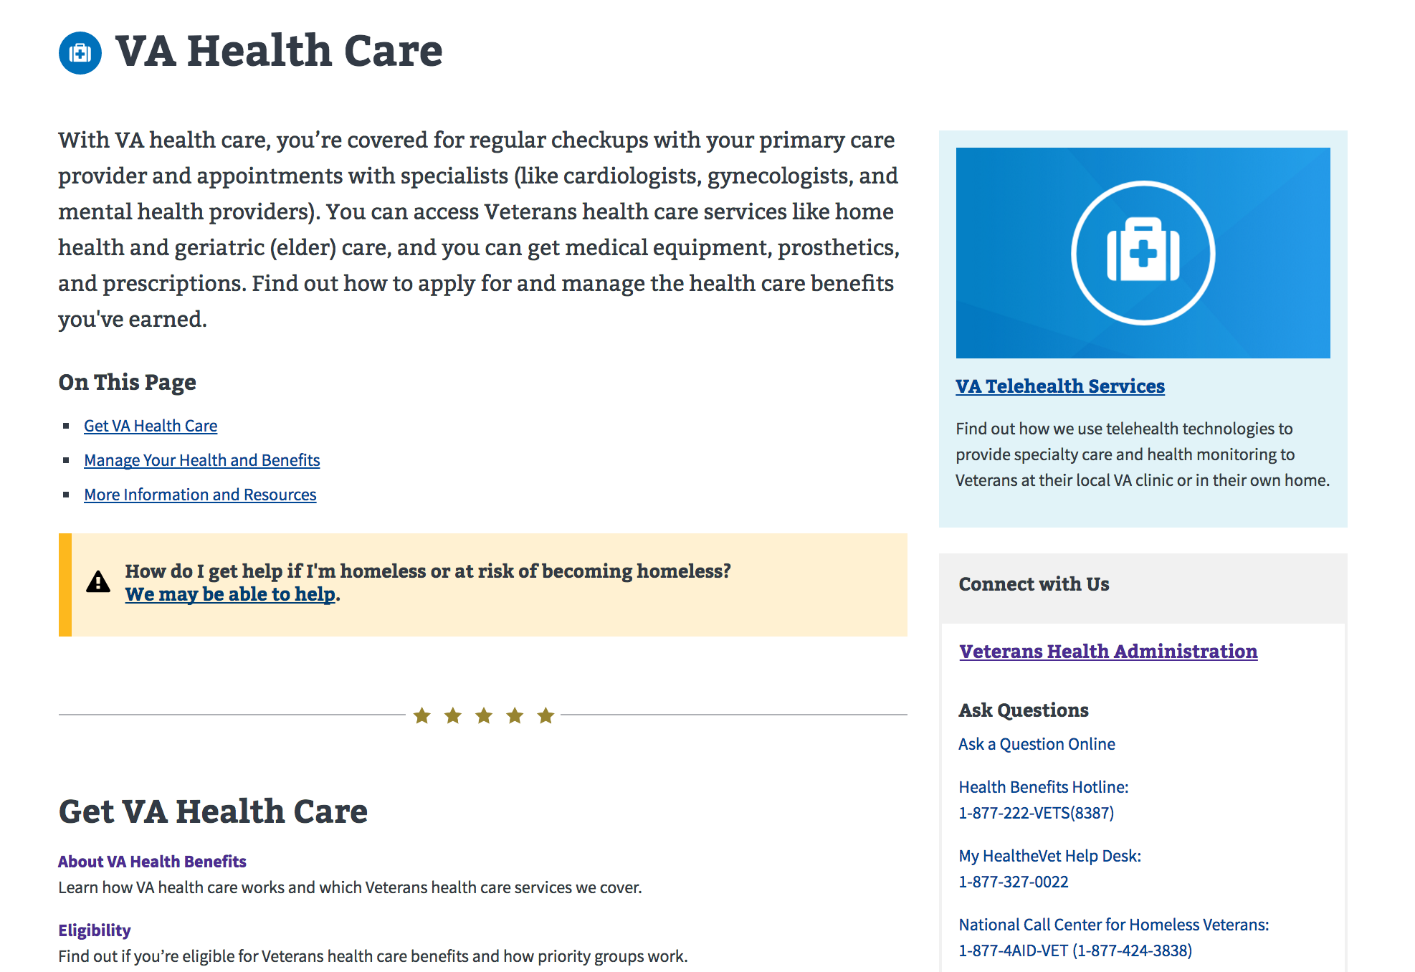
Benefit hubs and tool landing pages
Study 5 – Preview.va.gov Usability Test
Gathered info on the hub design and layout
Focused on the left navigation and call to action buttons on the tool landing pages

Slide 61
What are Veterans saying about preview.va.gov?
Study 5 – Preview.va.gov Usability Test
What are your impressions of this site?
"Nice categories, going to get into the areas that you're in. Looks like you're going to step your way on through” – Mobile P5
If this website went live tomorrow, what would you want other Veterans to know?
“I would encourage them that it’s a little easier to navigate” – Desktop P2
"Not to be afraid of it. It's not intimidating at all. I think without a lot of knowledge about the website you can get to where you need to go.” – Mobile P6

Slide 62
What are Veterans saying about preview.va.gov?
Study 5 – Preview.va.gov Usability Test
How did that compare to your past experiences with VA websites?
“…[old site] lots of clicking, at least 5 minutes to try to hunt down, this is better, a lot more organized, makes it easy to find what you are looking for, it’s right there in front of your face” – Desktop P4
“Everything is on one screen, all 4 areas, its more easier, it would make it more easier for veterans, its more informational, easier to find things.” – Desktop P5

Slide 63
Reception for the preview.va.gov homepage and navigation was extremely positive
Study 5 – Preview.va.gov Usability Test
Veterans liked and understood the benefit categories
The top tasks boxes drew users attention and they commented on the usefulness of the links
Homepage layout exposed Veterans to benefits they may not have considered
Browsing the top navigation worked well in both formats
Users understood the purpose of the “About VA” tab
VCL got good reception and emphasis from Veterans

Slide 64
Veterans called our attention to some improvements
Study 5 – Preview.va.gov Usability Test
The top tasks on the homepage worked well but Veterans overlooked the top navigation generally
The full benefit category list in the middle of the homepage did not catch their attention
Some users commented that the homepage was “flat” or “boring”

Slide 65
The hub and tool landing pages met Veterans needs
Study 5 – Preview.va.gov Usability Test
Users liked the hub page format and were successful browsing the headers, links, and text
Most users understood that many tasks would require sign-in to complete
The sign-in alert on the tool landing pages worked well
We watched across several users as they found multiple routes to key tasks such as Rx Refill

Slide 66
We found potential improvements for the hub and content pages
Study 5 – Preview.va.gov Usability Test
On desktop, the call to action button was outshined by the left navigation, leading users to mistakenly click the highlighted (current page) link
The volume of text on the Hub pages may have been overwhelming to some users
A few users expected to get straight to the sign-in page from the Hubs

Slide 67
What Now?
Study 5 – Preview.va.gov Usability Test
We will continue conducting in-person and remote usability testing on preview.va.gov, specifically drilling into key Veteran tasks to ensure our designs work.

Slide 68
Study 6 – Preview.va.gov Non-VA Vets

Slide 69
Our goal was to assess the usability of the preview.va.gov for Non-VA Veterans
Study 6 – Preview.va.gov Non-VA Vets
Remote user research on preview.va.gov homepage, navigation, and 3 new hubs (Disability, Education, Burials)
Spoke with 8 Veterans of varying ages and races
Used the live preview.va.gov website
Asked structured interview questions to get reactions to homepage followed by specific tasks in three hubs

Slide 70
Preview.va.gov Homepage
Study 6 – Preview.va.gov Non-VA Vets
Focused on first impressions and perceived messaging on the homepage
This is the new homepage for va.gov, what are your first impressions?
What kind of message do you think this new site sends to Veterans?
What do you think you can do on this page?

Slide 71
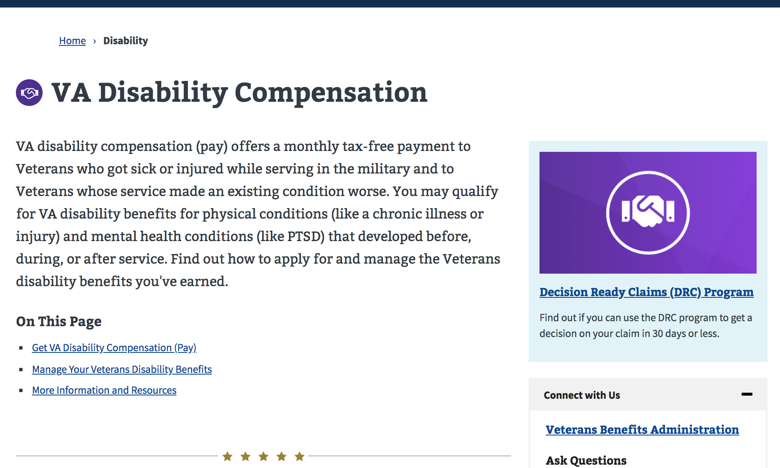
Benefit hubs tasks
Study 6 – Preview.va.gov Non-VA Vets
Gave users 6 scenarios to watch users navigate and accomplish specific tasks.
Disability Eligibility
Disability Upload Docs
Apply for Education
Transfer GI Bill Benefits
Burial Pre-need
Cemetery phone number

Slide 72
What are Veterans saying about preview.va.gov?
Study 6 – Preview.va.gov Non-VA Vets
What are your impressions of this site?
"It looks clean, search, contact us, find a location, it looks easy to use." -P1
"When it first came up on my screen, my first impressions were attractive, well laid out, I like the different colors." -P3
"There's a lot there, if I was coming in to look for something I would know where to start" -P9
"I like the way it's set up, like how it's focused on different areas, health care disability, education..." -P11

Slide 73
What are Veterans saying about preview.va.gov?
Study 6 – Preview.va.gov Non-VA Vets
What kind of message do you think this new site sends to Veterans?
"Trying to group areas to make it easier for Veterans to get to where they need to get to. Without going through 4-5 screens." -P3
"Accessible, willingness to help them find what they are looking for." -P4
"When I come on here I can clearly see that information I need is available, health care, disability, education, this is your one-stop-shop you need for Veteran related stuff." -P8
"Clean and clear, as a Veteran I have very specific questions, whether its health care, disability, education, or records. I like it, I don't have to go digging anywhere." -P12

Slide 74
What are Veterans saying about preview.va.gov?
Study 6 – Preview.va.gov Non-VA Vets
How did that compare to your past experiences with VA websites?
"Much easier, it was easy, very user friendly, intuitive about what to do. I just looked into each block, each one had a focus area. Once I found that, it was easy to follow the subheadings." -P1
"I do remember that (old VA site) was not very user friendly, this is very user friendly, it's very easy to navigate and its appealing and inviting." -P4

Slide 75
What are Veterans saying about preview.va.gov?
Study 6 – Preview.va.gov Non-VA Vets
If this website went live tomorrow, what would you want other Veterans to know?
"I would email other Veterans and tell them they really need to check out this website, it's not the website of old. They really need to check it out, they will probably find the information they are looking for fairly easily here." -P4
"It’s been re-designed and it’s easier to use. Thoroughly vetted to help allay their fears." -P9
"It’s out there and it’s easy to use. it covers everything a Veteran might need to know about, I’m excited to see this come out. so, I can see what areas I can use for myself in addition to the Tricare I have now.” -P11

Slide 76
Preview.va.gov is a hit!
Study 6 – Preview.va.gov Non-VA Vets
Feedback from non-VA veterans was overwhelmingly positive
Users appreciated the simplicity and layout of the homepage
Users generally completed the scenarios, but tasks that were not listed in the “top 4” boxes were much more difficult
VCL got good reception and emphasis from Veterans

Slide 77
Veterans called our attention to some improvements
Study 6 – Preview.va.gov Non-VA Vets
The top tasks on the homepage worked well but Veterans still tended to overlook the top navigation
Many Veterans did not scroll down the homepage, even when seeking benefits not in the “top 4” boxes
These resulted in significantly lower success rates for tasks not listed in the top tasks area (Avg. 54% vs 88% )
Users emphasized the importance of the VCL

Slide 78
Potential design solutions and discussions
Study 6 – Preview.va.gov Non-VA Vets
May need to revisit adding a View All option to the ”top 4” boxes
Modify the fold location so its apparent to the user that more options exist lower down the page
Make the top navigation stand-out more

Slide 79
What Now?
Study 6 – Preview.va.gov Non-VA Vets
We have additional user research planned for preview.va.gov prior to launch. We may need to make these design updates to raise the success rate of the less frequent tasks.

Slide 80
Study 7 – Preview.va.gov Usability Test 2

Slide 81
Our goal was to test the full Preview site with Veterans
Study 7 – Preview.va.gov Usability Test 2
In-person user research at the Durham VAMC
Spoke with 18 Veterans of varying ages and races
7 used the mobile site, 11 saw the desktop site
Used the live preview.va.gov website
Took a task-based approach to get feedback on the homepage, Veterans Crisis Line, Veteran images, login experience, and new left-navigation

Slide 82
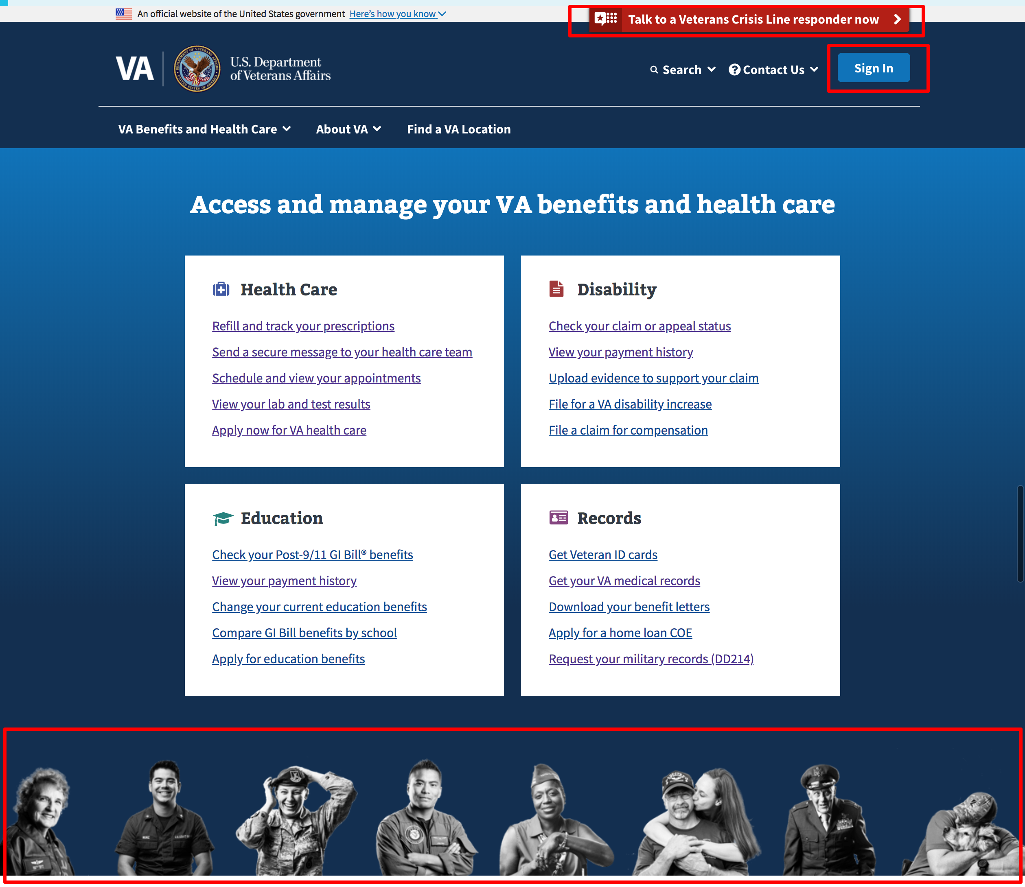
Preview.va.gov Homepage
Study 7 – Preview.va.gov Usability Test 2
On the homepage we focused on a few outstanding questions around:
Veteran’s Crisis Line
Veteran Images
Sign-in

Slide 83
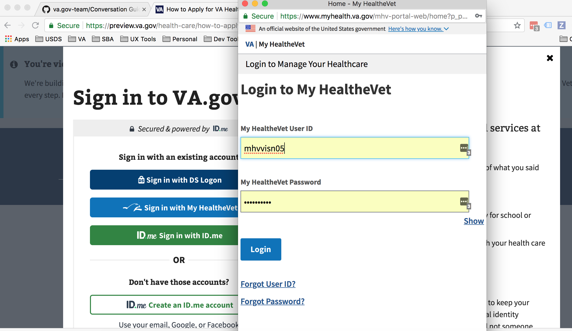
Login Experience
Study 7 – Preview.va.gov Usability Test 2
Watched users work through the sign-in flow for the first time:
Find the login button
Convert MHV account to ID.me
Access authenticated tools

Slide 84
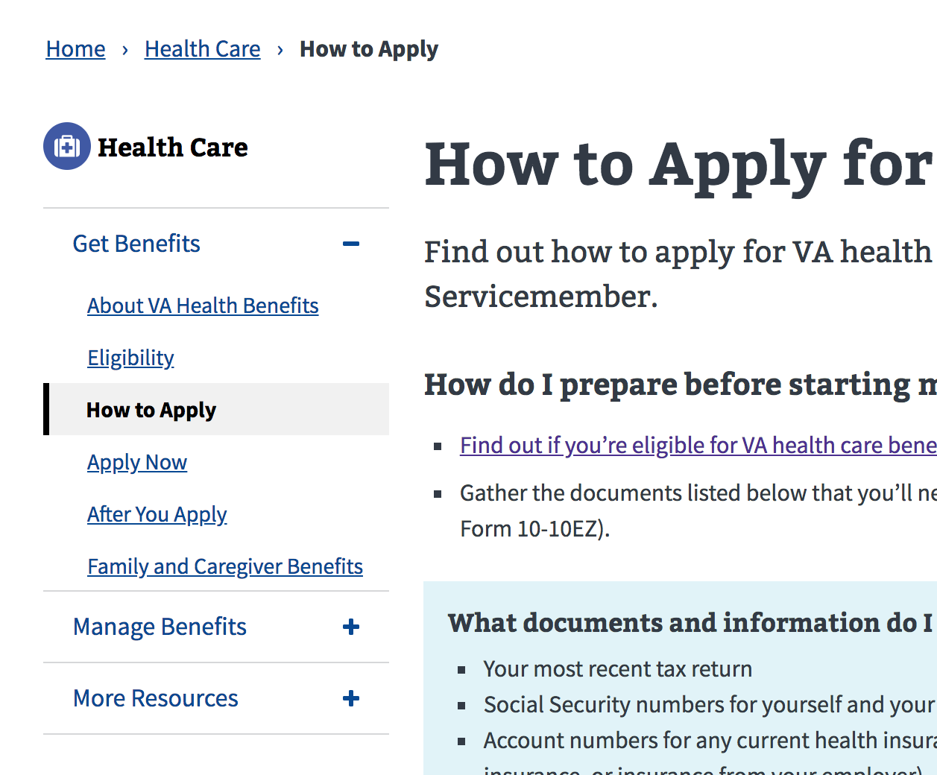
Updated components
Study 7 – Preview.va.gov Usability Test 2
Focused on testing other recently re-designed elements like the content page left navigation

Slide 85
Veteran Quotes for Preview
Study 7 – Preview.va.gov Usability Test 2
"It's a very useful source. Instead of calling a 1-800 number and waiting and waiting and waiting, you can get your payment info, your health care history. It's a very useful tool.” – DP4
"This is a one stop shop, right? One source login for everything, so you don't have to remember all the passwords.” – DP10
“They can go there and take care of things and VA will take care of them as opposed to coming up here [VAMC] and standing in line, they can do as much from home, that would help a lot of guys.” – MP1
“Oh night and day. You had a website and it wasn't as user friendly… There is so much more you can do with it and I believe it will save everybody time and money and help veterans.” – MP6

Slide 86
Veterans Crisis Line Quotes
Study 7 – Preview.va.gov Usability Test 2
"Then I would look for something that says help or crisis.” – DP8
“If you need help at 3am and you're depressed you call this number.” – DP8
"If a guy needs some help, you've got somebody to talk to." – DP9
“We're available 24/7.” – DP10
“It means that I would think that I had a friend that called me a lot who committed suicide that I would prefer to go this route to get help. That's just one example.” – MP6
“This is actually pretty easy. Its all touch you can text, start a confidential chat or even call.” – MP7

Slide 87
Veteran Images on Homepage Quotes
Study 7 – Preview.va.gov Usability Test 2
“It's fine. Showing the different retired guys. But the different branches.” – DP2
"It's got all the branches -- that's pretty cool.” – DP3
“Think it's fantastic. Represents all kinds of different people. Don't see anything offensive about it.” – DP5
“Don't see any marines there. You got Navy Coast guard. Air Force. WWII Army Air Corp. Don't see any marines.” – DP10
“I think its pretty nice. Different veterans that come from different walks of life.” – MP1
“Some people look like they are officially in service and some look like they are spouses. Being a veteran I like seeing them.” – MP7

Slide 88
Between day 1 and day 2 of this study two key usability issues were resolved
Study 7 – Preview.va.gov Usability Test 2
The left navigation component on the content pages was not displaying the updated version – FIXED
Single sign-on to MHV was not functioning – FIXED

Slide 89
We learned a lot about the Veteran Experience
Study 7 – Preview.va.gov Usability Test 2
Veterans are generally returning to the homepage to accomplish tasks after being logged-in, not the dashboard
On MHV, users are able to find the most common tasks
Several Veterans were hesitant to provide their email address and phone number when converting MHV credentials to ID.me
Most Veterans did not find the VCL through the top banner, they either noticed the button or the footer link

Slide 90
We learned a lot about the Veteran Experience
Study 7 – Preview.va.gov Usability Test 2
Veterans had mixed feedback about the “Contact Us” information on the hub pages
The new left navigation corrects the usability issues found in Study 5
Veterans were not confused by the multiple sign-in options (MHV, DS Logon, ID.me)
Open in new tab function failing from the tool landing pages, either because the new tab to MHV/eBN doesn’t open or it gets blocked

Slide 91
Potential design solutions and discussions
Study 7 – Preview.va.gov Usability Test 2
The single sign-on issues with MHV and the new tab usability issues must be fixed before launch
Split the contact us section into two sections - phone numbers and social media links
Keep the VCL copy the same do not rely solely on the banner to drive users to that information
Longer-term the flow to convert an MHV account to ID.me account should be simplified

Slide 92
What Now?
Study 7 – Preview.va.gov Usability Test 2
We have a few critical updates to make and another round of testing coming up next week. We need to focus on fixing major usability issues prior to launch and generating a backlog for post-launch.

Slide 93
Study 8 – Preview.va.gov Authenticated Test

Slide 94
Our goal was to watch users with accounts work through preview top tasks
Study 8 – Preview.va.gov Authenticated Test
Remote user research on preview.va.gov authenticated experience
Recruited users with MHV, eBN, or ID.me accounts
Spoke with 9 Veterans of varying ages and races
Used the live preview.va.gov website
Task based: Gave users key tasks on va.gov which required login

Slide 95
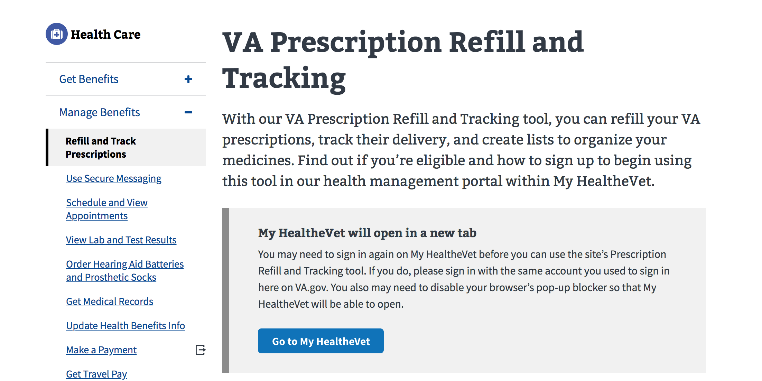
Veterans worked through several top tasks with their accounts
Study 8 – Preview.va.gov Authenticated Test
Refill Prescriptions
Secure Messaging
Check Vitals
Check Claim Status
Upload Evidence
Check Payment History

Slide 96
We confirmed key login tasks worked
Study 8 – Preview.va.gov Authenticated Test
Veterans were able to find the ”Sign In” box to login to their account
Users were able to complete MHV and eBN tasks from the VA.gov homepage
MHV and DS Logon users were able to see their dashboard and data on VA.gov
The ”My VA” and “My Health” tabs are working
Veterans easily located the drop-down with their name to log out and access settings

Slide 97
Veterans had mixed feedback about the login experience
Study 8 – Preview.va.gov Authenticated Test
“I like it’s actually going fairly quick. Usually when you have to connect your account, takes forever.” – P1
“Would be better if I didn’t have to click to open another tab. Better if it automatically opened in another tab.” - P1
“I would go to ebenefits. Of course I have to relog in, and I don’t like that. Wish it were directly connected.” – P2
“I wouldn’t want it every time (reauthentication 2FA) but I like that it’s quick.” - P2
“One concern I have is if a person isn't adept with both of these devices they might get ... if I have to do this every time?” – P3
“That is my account. I hope they're not making me change. It won't accept it. Doggone it. No, this is for VA.” – P8

Slide 98
We found several usability issues
Study 8 – Preview.va.gov Authenticated Test
Logging-out on VA.gov is not logging the user out of their MHV account
Veterans are generally not finding “My VA” and “My Health” in the top right of the page
Deep links into eBenefits are not useful, users attempting to upload documentation cannot complete task
Each new tab opening up eBenefits requires user to login again, credential is not being shared across tabs

Slide 99
Potential design solutions and discussions
Study 8 – Preview.va.gov Authenticated Test
Need to fix the few outstanding login bugs before launch
We may need to address the location/visual appeal of the “My VA” and ”My Health” tabs
Labels for Account Settings / Profile / My VA are not clearly differentiated for users
We need to work with the eBenefits team to make sure links to top tasks are usable from landing pages

Slide 100
What Now?
Study 8 – Preview.va.gov Authenticated Test
We are preparing the final changes prior to launch. All remaining issues are added to the backlog for post-launch prioritization.

Slide 101
Thank you!
Contact Jeff Barnes with questions:
jeffrey.barnes4@va.gov

